Slide 1

Atiq Hospitality Analysis

Slide 2
Objective
Atliq Grands
Atliq Exotica
Atliq Palace
Atliq City
Atliq Blu
Atliq Bay
Atliq Seasons
Our objective is to enhance Atliq Grands market share and revenue in the luxury and business by implementing data driven strategies and empower management with insights to make decisions.

Slide 3
Categories
Luxury Property
Business Property
Atliq Grands
Atliq Exotica
Atliq Blu
Atliq Bay
Atliq City
Atliq Palace
Atliq Seasons
Room Class
Room Category
Standard
Elite
Premium
Presidential
RT1
RT2
RT3
RT4

Slide 4
Key Metrics
Revenue
Bookings
From May to July we have 134.59K total bookings.
Among total bookings 94K are successful bookings and 33K are cancelled.
Week days has more bookings than weekends.
Among total bookings 25% of them are cancelled.
Booking Via other platform is higher than bookings via online platforms.
Luxury property has more booking than business property.
May month has higher bookings.
Atliq Palace has more bookings than other property.
Bookings in Mumbai city is higher than other cities.
Total Revenue : 1709 M.
Average Ratings: 1.52.
Total Capacity: 233K.
Occupancy Rate: 57.87%.
Cancellation Rate: 24.8%.
May month has highest revenue rate and June month has least.
Mumbai city contributes highest revenue and the least contributor is Delhi.
Highest revenue is from Atliq Exotica Luxury property and the least is from Atliq Season Business property.
Revenue from Elite rooms is higher than other room class.
RT2 Category rooms provides highest revenue and the least is from RT1 category

Slide 5
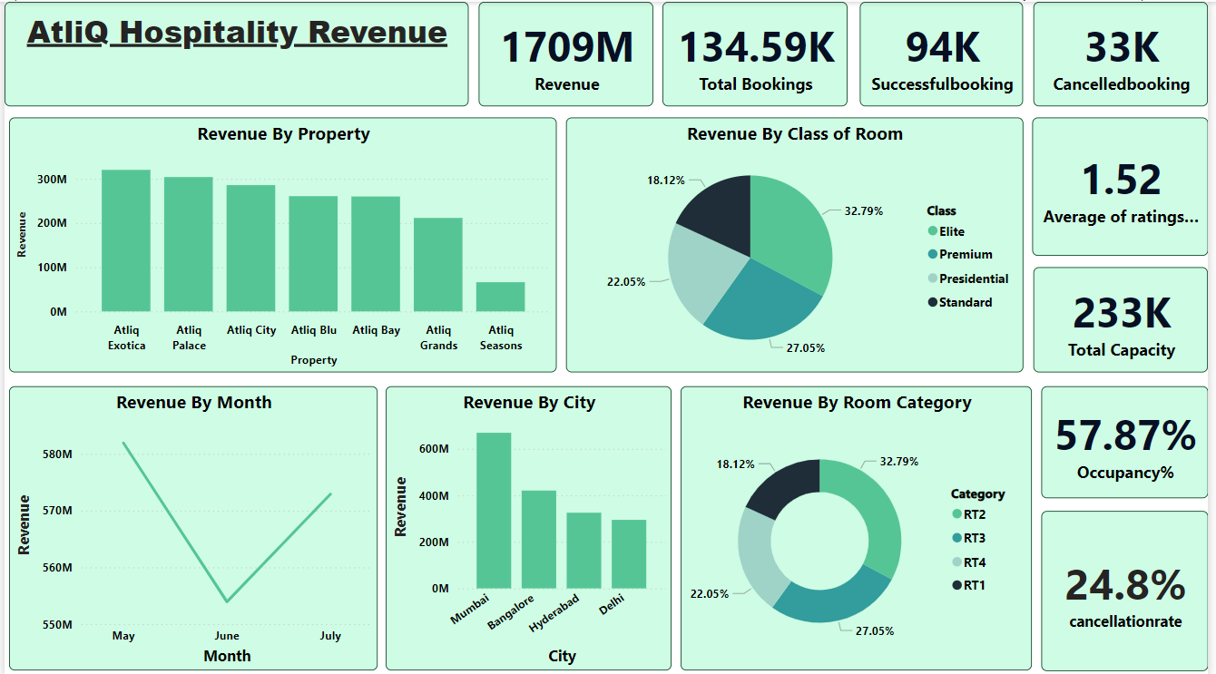
Revenue Analysis

Slide 6
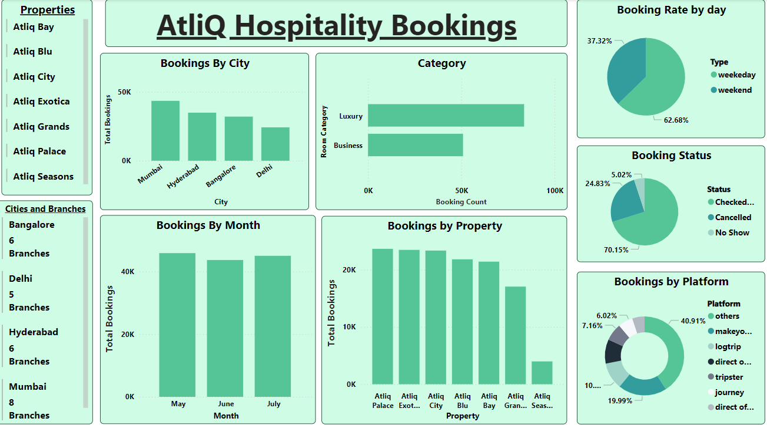
Bookings Analysis

Slide 7
Recommendations:
Ensure website and booking platforms are user friendly, informative and visually appealing.
Streamline check-in process to minimize wait times, offering online check-ins and self service kiosks.
Warm welcome with bright smile and provide a complimentary welcome drink or refreshment.
Ensure rooms are spotlessly clean and well maintained, providing comfortable beds, essential amenities, WiFi and charging stations.
Providing variety dining options including room service along with food quality and consistent service.
Maintain high quality recreational facility such as pools, fitness centers and spas.
Offer business amenities like meeting hall, high speed internet and office supplies for business travelers.
Smooth check out process, Thank guest for their stay and invite them to return also offer small token of appreciation such as discount in future stay
Regularly monitor and analyze online reviews to identify trends and areas of improvement.
Implement changes based on feedback and industry best practices, continuously train staff and update facilities to maintain high standards.

Slide 8


